Slide 1
 | Young people 10-25
 | ID | Baking | Math | Soccer | Handball | Cptr Game | Genre
Training | 1 | 1 | 0 | 0 | 1 | 0 | F
 | 2 | 0 | 1 | 1 | 0 | 1 | M
 | 3 | 0 | 1 | 1 | 1 | 1 | M
 | 4 | 1 | 1 | 0 | 1 | 0 | F
 | 5 | 1 | 1 | 0 | 1 | 1 | F
 | 6 | 0 | 0 | 0 | 1 | 1 | F
 | 7 | 0 | 0 | 0 | 0 | 0 | F
 | 8 | 1 | 0 | 0 | 0 | 0 | F
 | 9 | 0 | 0 | 1 | 1 | 0 | M
 | 10 | 0 | 1 | 0 | 1 | 0 | F
 | 11 | … | … | … | … | … | …
 | 12 | … | … | … | … | … | …
Data

Slide 2
 | Young people 10-25
 | ID | Baking | Math | Soccer | Handball | Cptr Game | Genre
Training1 | 1 | 1 | 0 | 0 | 1 | 0 | F
 | 2 | 0 | 1 | 1 | 0 | 1 | M
 | 3 | 0 | 1 | 1 | 1 | 1 | M
 | 4 | 1 | 1 | 0 | 1 | 0 | F
 | 5 | 1 | 1 | 0 | 1 | 1 | F
Test | 6 | 1 | 1 | 1 | 1 | 1 | ?
Data row Split
 | Young people 10-25
 | ID | Baking | Math | Soccer | Handball | Cptr Game | Genre
Training2 | 6 | 0 | 0 | 0 | 1 | 1 | F
 | 7 | 0 | 0 | 0 | 0 | 0 | F
 | 8 | 1 | 0 | 0 | 0 | 0 | F
 | 9 | 0 | 0 | 1 | 1 | 0 | M
 | 10 | 0 | 1 | 0 | 1 | 0 | F
Test | 11 | … | … | … | … | … | ?

Slide 3
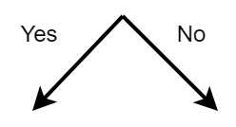
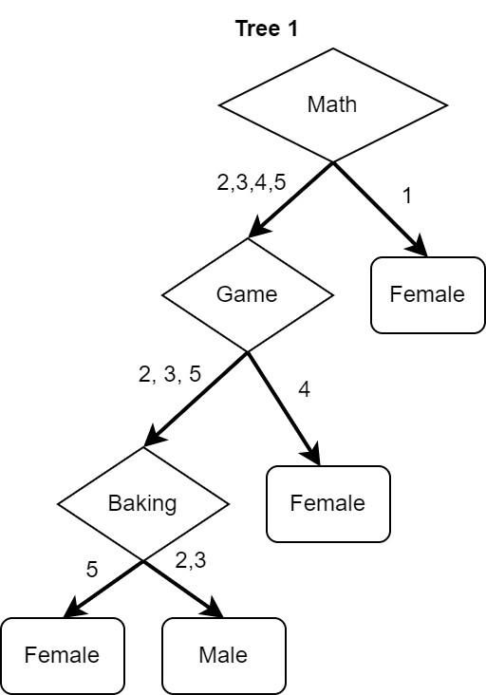
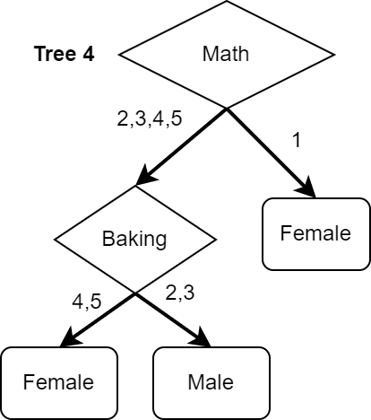
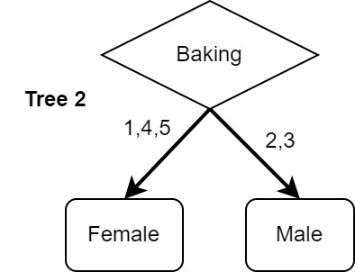
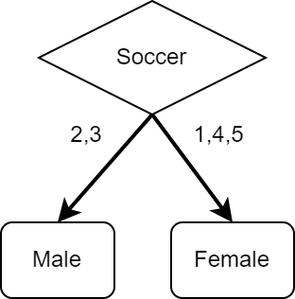
 | Young people 10-25
 | ID | Baking | Math | Soccer | Handball | Cptr Game | Genre
Training1 | 1 | 1 | 0 | 0 | 1 | 0 | F
 | 2 | 0 | 1 | 1 | 0 | 1 | M
 | 3 | 0 | 1 | 1 | 1 | 1 | M
 | 4 | 1 | 1 | 0 | 1 | 0 | F
 | 5 | 1 | 1 | 0 | 1 | 1 | F
Test | 6 | 1 | 1 | 1 | 1 | 1 | ?
Training Phase
Feature Selection
Tree 3
Tree 4
Tree 2
Tree 1

Slide 4
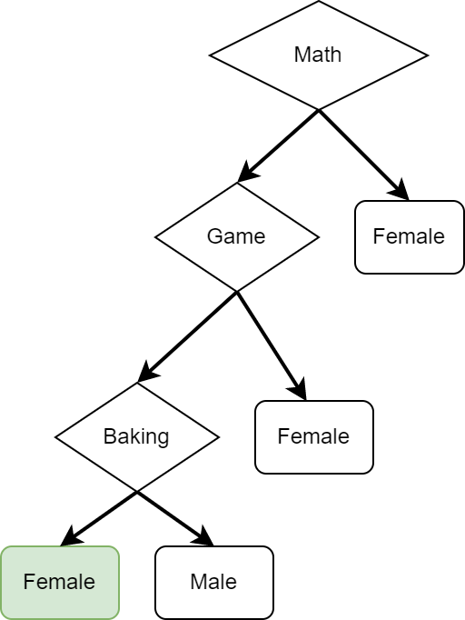
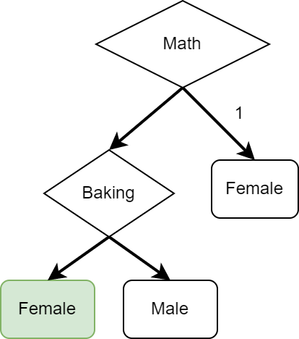
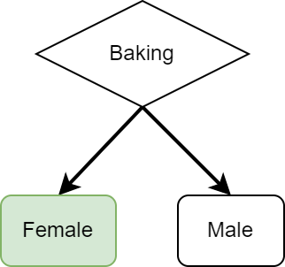
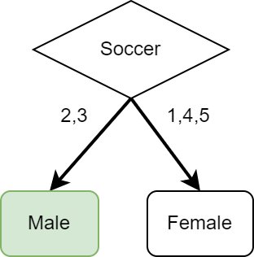
 | Young people 10-25
 | ID | Baking | Math | Soccer | Handball | Cptr Game | Genre
Training1 | 1 | 1 | 0 | 0 | 1 | 0 | F
 | 2 | 0 | 1 | 1 | 0 | 1 | M
 | 3 | 0 | 1 | 1 | 1 | 1 | M
 | 4 | 1 | 1 | 0 | 1 | 0 | F
 | 5 | 1 | 1 | 0 | 1 | 1 | F
Test | 6 | 1 | 1 | 1 | 1 | 1 | ?
Aggregation
Tree 1
Tree 4
Tree 2
Tree 3
Female: 3
Male: 1
Winner = Female

Slide 5
Testing Phase
 | Young people 10-25
 | ID | Baking | Math | Soccer | Handball | Cptr Game | Genre
Training1 | 1 | 1 | 0 | 0 | 1 | 0 | F
 | 2 | 0 | 1 | 1 | 0 | 1 | M
 | 3 | 0 | 1 | 1 | 1 | 1 | M
 | 4 | 1 | 1 | 0 | 1 | 0 | F
 | 5 | 1 | 1 | 0 | 1 | 1 | F
Test | 6 | 1 | 1 | 1 | 1 | 1 | F
Female: 3
Male: 1
Aggregation
Winner = Female

Slide 6
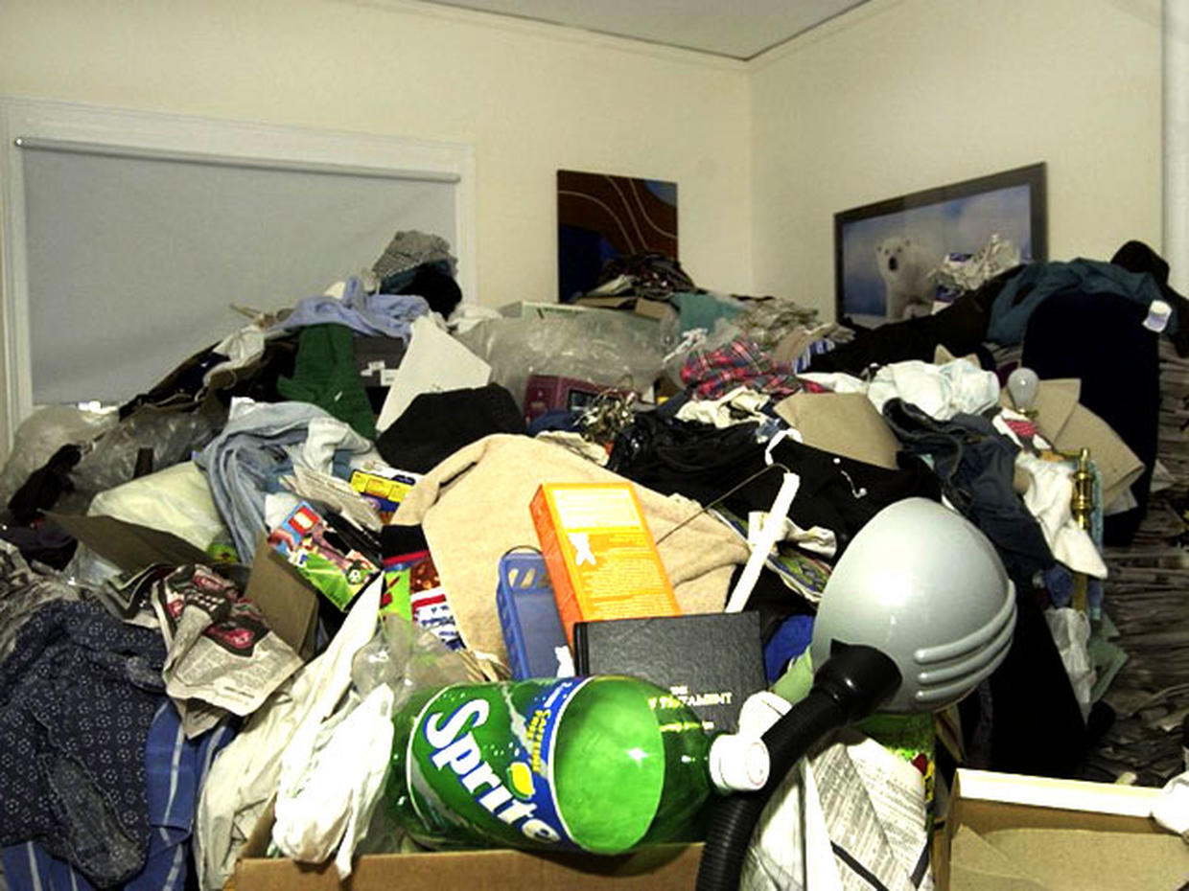
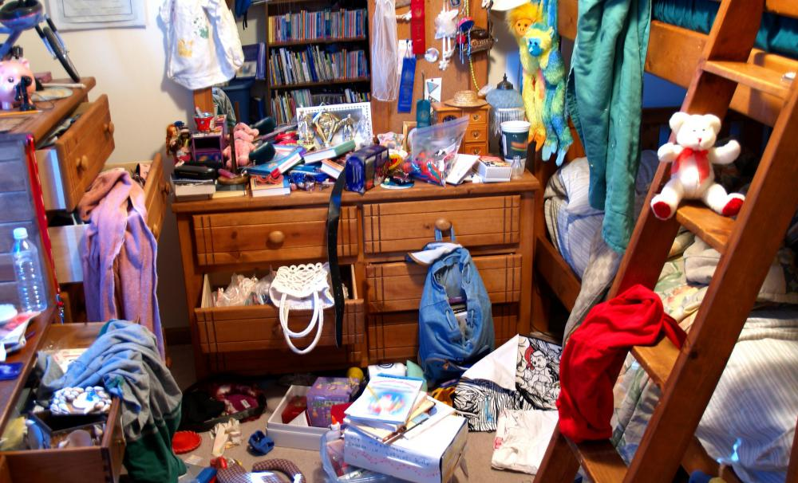

Slide 7
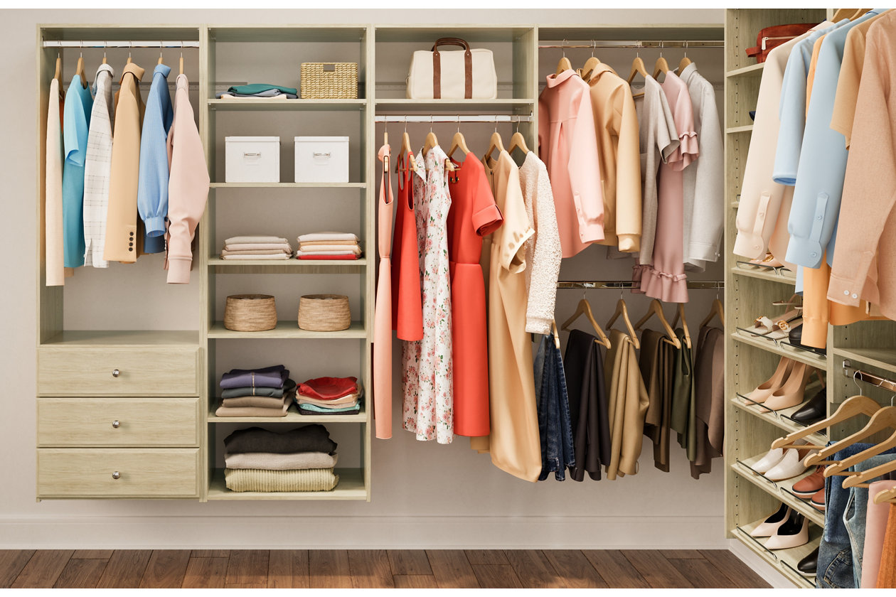

Slide 8
Rate of disorder,
Rate of randomness

Slide 9
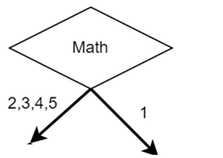
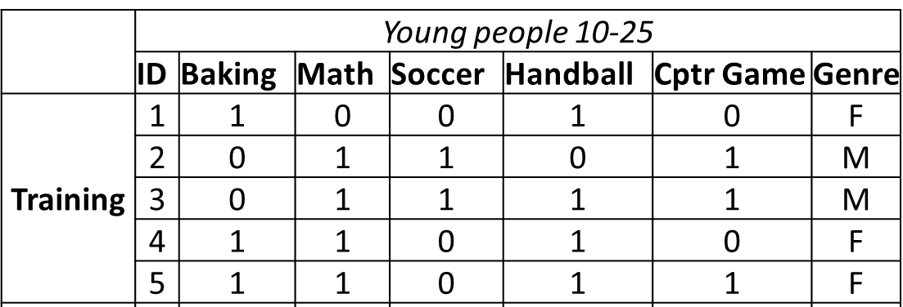
M,M,F,F
F

Slide 10
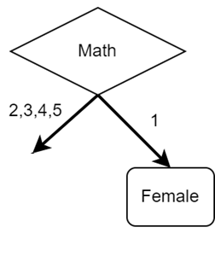
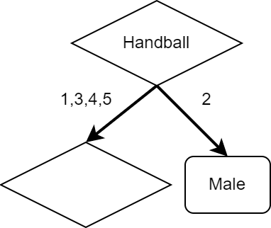
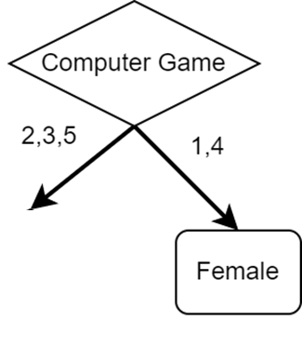
M,M,F,F
F,M,F,F
F
M,M
F,F,F
F,F,F
M,M
M,M,F

Slide 11
INFORMATION GAIN
Find the code here
https://github.com/tchamna/information_gain_and_entropy_decision_tree

Slide 12
F,F,F
M,M
Parent: F,M,M,F,F
E(parent) = 0.97

Slide 13
M,M,F,F
Parent: F,M,M,F,F
E(parent) = 0.72

Slide 14
M,M
F,F,F
Parent: F,M,M,F,F
E(parent) = 0.97

Slide 15
M,M,F,F
F,M,F,F
F
M,M
F,F,F
F,F,F
M,M
M,M,F

